Slide 2
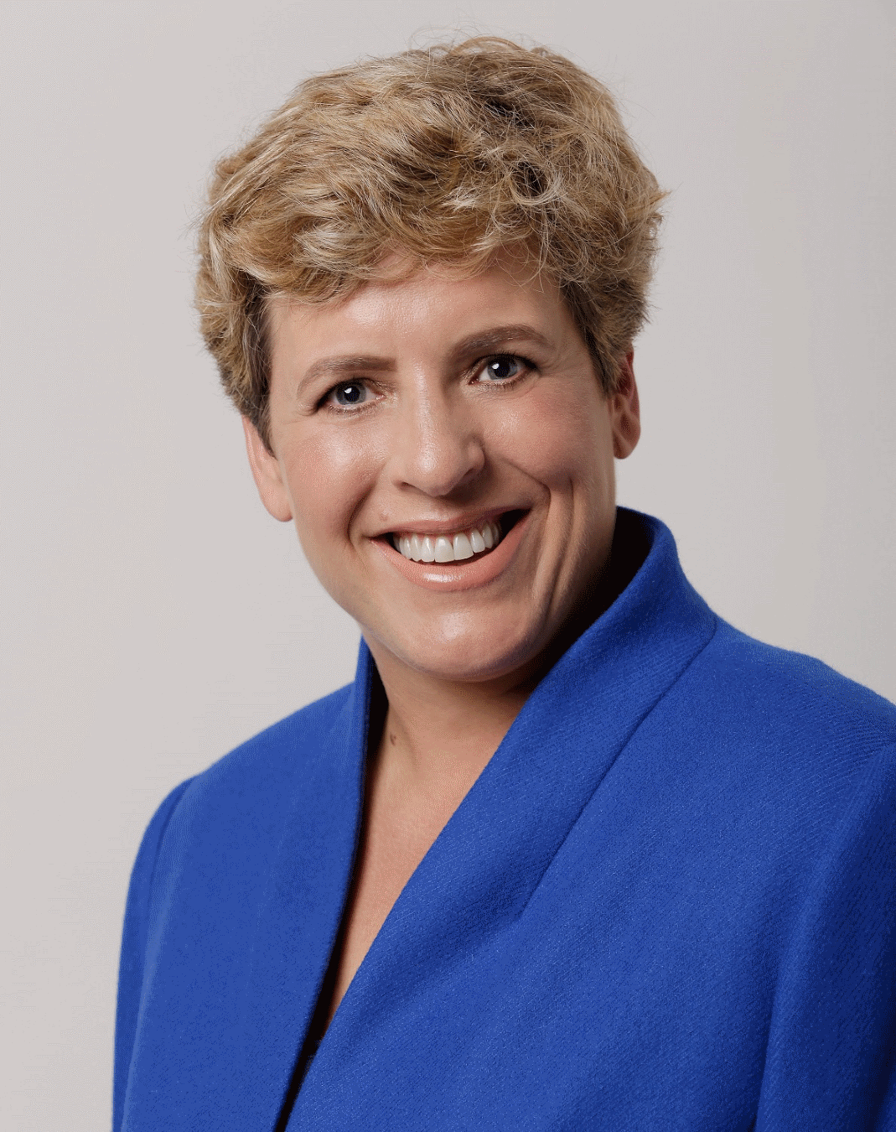

CAI3SP
ACKNOWLEDGMENT
PROGRAM ADDRESS
Curtin Academy International
Interdisciplinary Industry Study Program
(CA-I3SP)
Assoc. Professor Rachel Sheffield
Curtin Academy Chair & Program Lead
Curtin University
PEOPLE
people-centred
PEDAGOGY
globally-placed
PRACTICE
paradigm-shifters
CRICOS Provider Code 00301J
Notes:
CA-I3SP has been the first Curtin mobility program to provide students with the important triple “I” experience of an international interdisciplinary industry-focused research study.

Slide 3

















The CURTIN ACADEMY
CURTIN ACADEMY SUSTAINABLE FUTURE
Our Sustainable Future: Planet, People, Partnership
Miri, Sarawak, Malaysia
December 09, 2022
January 08, 2023
Hosted by
CRICOS Provider Code 00301J
Proud Collaborators

Slide 4

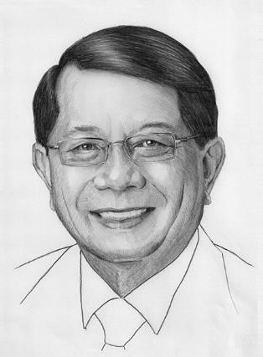
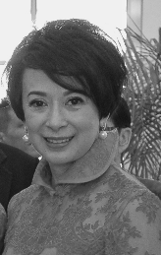
CAI3SP
ACKNOWLEDGMENT
(From Left to Right)
Tan Sri Datuk Patingi
Dr George Chan
Pro Chancellor, Curtin Malaysia
Datin Patinggi Puan Sri Datuk
Lorna Enan Muloon Chan
PEOPLE
people-centred
PEDAGOGY
globally-placed
PRACTICE
paradigm-shifters
CRICOS Provider Code 00301J
Notes:
CA-I3SP has been the first Curtin mobility program to provide students with the important triple “I” experience of an international interdisciplinary industry-focused research study.

Slide 5
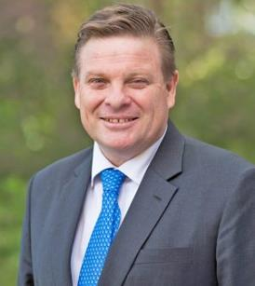
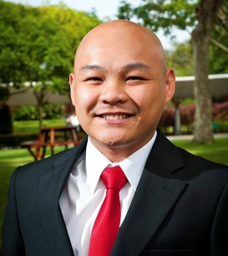
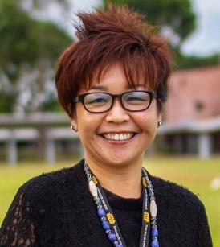
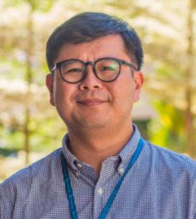
CAI3SP
ACKNOWLEDGMENT
CURTIN MALAYSIA STAFF
(Clockwise From Top Left)
Professor Simon Leunig
Pro Vice-Chancellor & President
Curtin Malaysia
Professor Vincent Lee
Chieng Chen
Deputy Pro Vice-Chancello
Curtin Malaysia
Professor Fu Ee Tang
Dean of Teaching and Learning
Curtin Malaysia
Ms Cherina Chiew
Manager, Intenational Student Office
Curtin Malaysia
PEOPLE
people-centred
PEDAGOGY
globally-placed
PRACTICE
paradigm-shifters
CRICOS Provider Code 00301J
Notes:
CA-I3SP has been the first Curtin mobility program to provide students with the important triple “I” experience of an international interdisciplinary industry-focused research study.

Slide 6
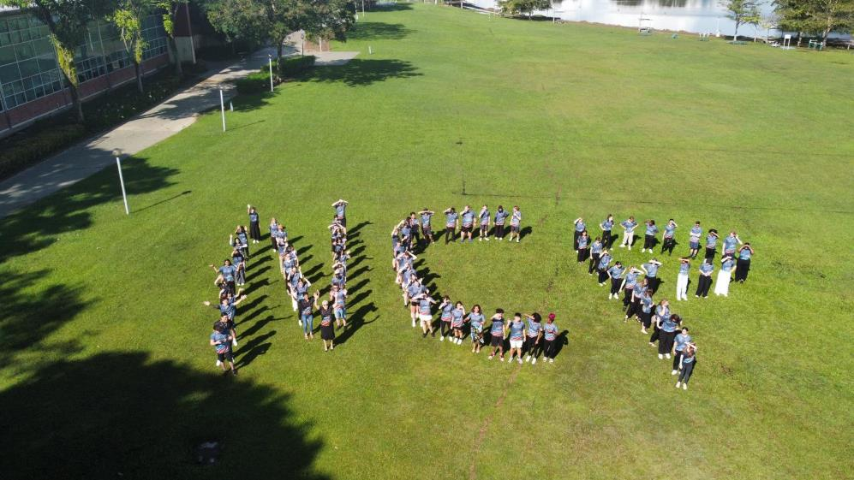
CAI3SP
ACKNOWLEDGMENT
NCP 01 Students
Faculty of Health Sciences
Faculty of Humanities
Faculty of Science and Engineering
Faculty of Business & Law
PEOPLE
people-centred
PEDAGOGY
globally-placed
PRACTICE
paradigm-shifters
CRICOS Provider Code 00301J
Notes:
CA-I3SP has been the first Curtin mobility program to provide students with the important triple “I” experience of an international interdisciplinary industry-focused research study.

Slide 7
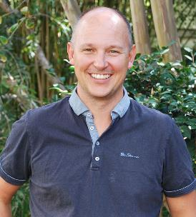

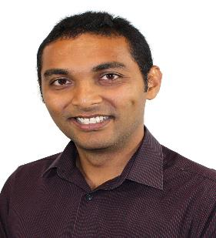
CAI3SP
ACKNOWLEDGMENT
NCP01 – MIRI, SARAWAK
Curtin Perth Staff
(Clockwise From Top Left)
Dr Ben Milbourn
Curtin School of Allied Health
Faculty of Health Sciences
Ms Nikki Fairhurst
School of Education
Faculty of Humanities
Dr Wahseem Soobratty
School of Accounting, Economics & Finance
Faculty of Business & Law
PEOPLE
people-centred
PEDAGOGY
globally-placed
PRACTICE
paradigm-shifters
CRICOS Provider Code 00301J
Notes:
CA-I3SP has been the first Curtin mobility program to provide students with the important triple “I” experience of an international interdisciplinary industry-focused research study.

Slide 8
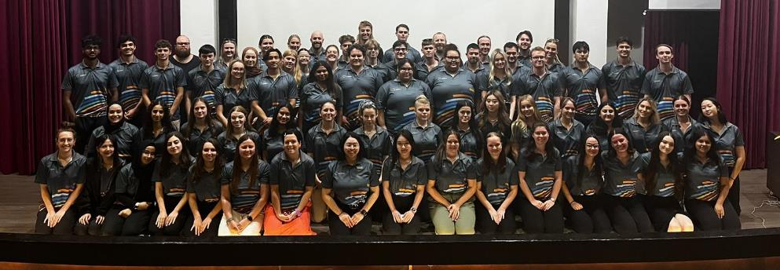
CAI3SP
ACKNOWLEDGMENT
NCP 02 Students
Faculty of Health Sciences
Faculty of Humanities
Faculty of Science and Engineering
Faculty of Business & Law
PEOPLE
people-centred
PEDAGOGY
globally-placed
PRACTICE
paradigm-shifters
CRICOS Provider Code 00301J
Notes:
CA-I3SP has been the first Curtin mobility program to provide students with the important triple “I” experience of an international interdisciplinary industry-focused research study.

Slide 9

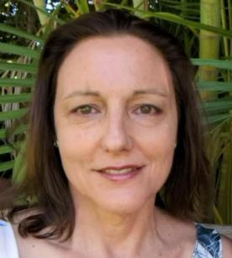
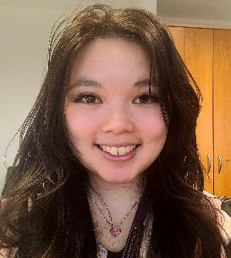

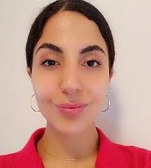
CAI3SP
ACKNOWLEDGMENT
NCP02 – MIRI, SARAWAK
Curtin Perth Staff
(Clockwise From Top Left)
Assoc. Professor Rekha Koul
School of Education
Faculty of Humanities
Dr Joanne Castelli
Educational Designer, STEM
Faculty of Science & Engineering
Ms Yvonne Lau
Student Experience (Faculty Operations)
Faculty of Business & Law
Ms Madeline Ayoub
Research Stipend
Curtin Graduate Research School
Ms Christina Chong
Student Experience Coordinator
Faculty of Science & Engineering
PEOPLE
people-centred
PEDAGOGY
globally-placed
PRACTICE
paradigm-shifters
CRICOS Provider Code 00301J
Notes:
CA-I3SP has been the first Curtin mobility program to provide students with the important triple “I” experience of an international interdisciplinary industry-focused research study.

Slide 10














The CURTIN ACADEMY
CURTIN ACADEMY SUSTAINABLE FUTURE
New Colombo Plan Mobility Program
Our Sustainable Future: Planet, People, Partnership
Singapore
January 2023
Organiser
Proud Collaborators
Hosted by
CRICOS Provider Code 00301J

Slide 11
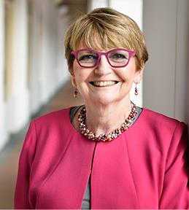

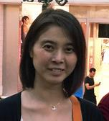
CAI3SP
ACKNOWLEDGMENT
NCP03 - SINGAPORE
Curtin Singapore Staff
PEOPLE
people-centred
PEDAGOGY
globally-placed
PRACTICE
paradigm-shifters
(Clockwise From Top Left)
Professor Linley Lord
President & Pro Vice-Chancellor
Curtin Singapore
Dr Carolyn Koh
Director Research, External Engagement
Curtin Singapore
Ms Lee Nah Wong
Director of Academic Services
Curtin Singapore
CRICOS Provider Code 00301J
Notes:
CA-I3SP has been the first Curtin mobility program to provide students with the important triple “I” experience of an international interdisciplinary industry-focused research study.

Slide 12
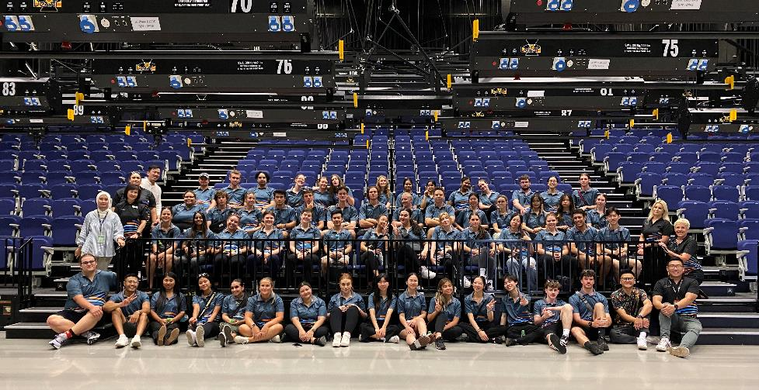
CAI3SP
ACKNOWLEDGMENT
NCP Singapore Students
Faculty of Health Sciences
Faculty of Humanities
Faculty of Science and Engineering
Faculty of Business & Law
PEOPLE
people-centred
PEDAGOGY
globally-placed
PRACTICE
paradigm-shifters
CRICOS Provider Code 00301J
Notes:
CA-I3SP has been the first Curtin mobility program to provide students with the important triple “I” experience of an international interdisciplinary industry-focused research study.

Slide 13
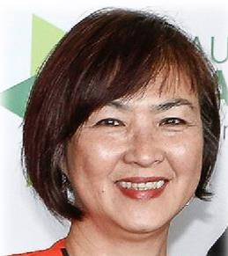
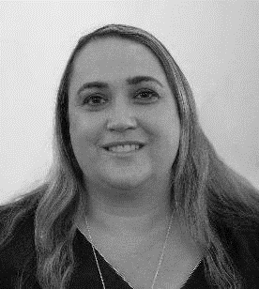
CAI3SP
ACKNOWLEDGMENT
NCP03 – SINGAPORE
Curtin Perth Staff
(Clockwise From Top Left)
Assoc. Professor Lisa Tee
Curtin Medical School
Faculty of Health Sciences
Ms Nikki Fairhurst
School of Education
Faculty of Humanities
Mrs Michelle De Kok
School of Education
Faculty of Humanities
PEOPLE
people-centred
PEDAGOGY
globally-placed
PRACTICE
paradigm-shifters
CRICOS Provider Code 00301J
Notes:
CA-I3SP has been the first Curtin mobility program to provide students with the important triple “I” experience of an international interdisciplinary industry-focused research study.

Slide 14
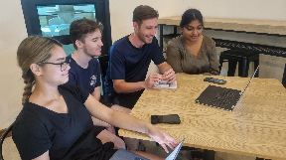
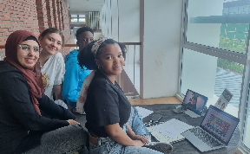
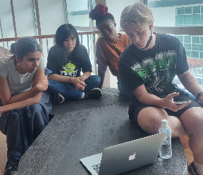
CAI3SP
ACKNOWLEDGMENT
Curtin Academy
Mentorship Program
Dr. Leo Ng
Curtin School of Allied Health
Faculty of Health Sciences
Dr. Jun Chih
Curtin School of Population Health
Faculty of Health Sciences
Assoc. Professor Janie Brown
Curtin School of Nursing
Faculty of Health Sciences
Dr. Dave Parsons
Curtin School of Allied Health
Faculty of Health Sciences
Assoc. Professor Subra Ananthram
Dean of Learning and Teaching
Faculty of Business & Law
Dr. Shafiiq Gopee
Head of Learning & Teaching
Curtin Mauritius
John Curtin Distinguished
Professor Dale Pinto
Curtin Law School
Faculty of Business & Law
Assoc. Professor Lisa Tee
Curtin Medical School
Faculty of Health Sciences
Assoc Professor Rachel Sheffield
School of Education
Faculty of Humanities
Assoc. Professor Cesar
Ortega-Sanchez
School of Elec Eng, Comp & Math Sci (EECMS)
Faculty of Science & Engineering
Professor Natalie Gasson
Curtin School of Population Health
Faculty of Health Sciences
PEOPLE
people-centred
PEDAGOGY
globally-placed
PRACTICE
paradigm-shifters
CRICOS Provider Code 00301J
Notes:
CA-I3SP has been the first Curtin mobility program to provide students with the important triple “I” experience of an international interdisciplinary industry-focused research study.

Slide 15
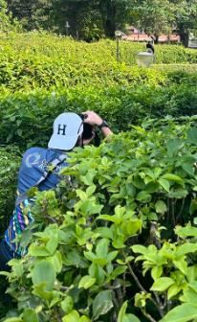
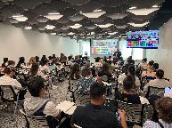
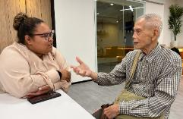
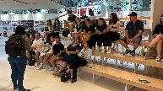
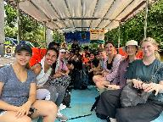
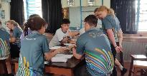
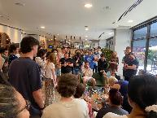
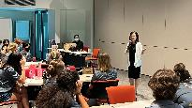
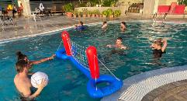
CAI3SP
ACKNOWLEDGMENT
Curtin Perth Staff
Ms. Ashlyn Hendrick
Critical Incident Risk Manager
Curtin University
Ms. Susan Chung
Travel Operations Manager
Curtin University
Ms Natalie Love
Student Services Team Leader
Curtin University
Mr. Simon Kerrigan
Curriculum Project Officer
Curtin University
Ms. Karen Clay
Faculty of Humanities
Curtin University
Finance Teams
Student Engagement Teams
Deans and Pro Vice Chancellors
PEOPLE
people-centred
PEDAGOGY
globally-placed
PRACTICE
paradigm-shifters
CRICOS Provider Code 00301J

Slide 16
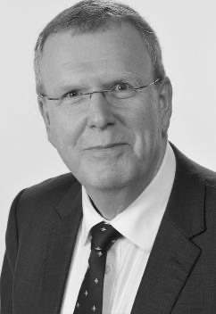
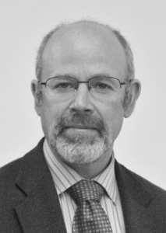
CAI3SP
ACKNOWLEDGMENT
(From Left to Right)
Professor Paul Brunton
Deputy Vice-Chancellor – Academic
Curtin University
Professor Seth Kunin
Deputy Vice-Chancellor – Global
Curtin University
PEOPLE
people-centred
PEDAGOGY
globally-placed
PRACTICE
paradigm-shifters
CRICOS Provider Code 00301J
Notes:
CA-I3SP has been the first Curtin mobility program to provide students with the important triple “I” experience of an international interdisciplinary industry-focused research study.

Slide 17
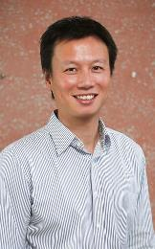
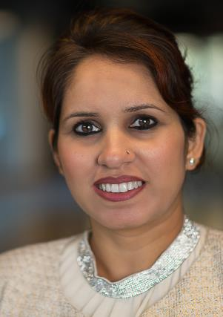
CAI3SP
ACKNOWLEDGMENT
CA NCP Study
Tour Showcase
& Perth Summit
(From Left to Right)
Dr. Leo Ng
NCP Study Tour Showcase Coordination
Curtin University
Assoc. Professor Sherry Bawa
Perth Summit Coordination
Curtin University
PEOPLE
people-centred
PEDAGOGY
globally-placed
PRACTICE
paradigm-shifters
CRICOS Provider Code 00301J
Notes:
CA-I3SP has been the first Curtin mobility program to provide students with the important triple “I” experience of an international interdisciplinary industry-focused research study.

Slide 18
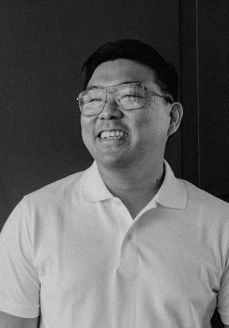
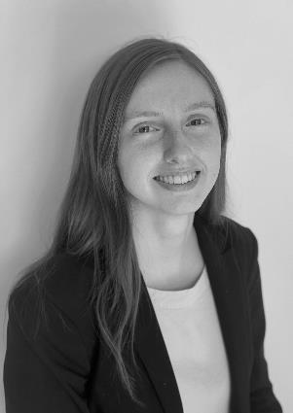
CAI3SP
ACKNOWLEDGMENT
Program Coordination
(From Left to Right)
Mr. Chris Leong
Project Officer
Curtin University
Ms. Stephanie Bruce
Program Coordinator
Curtin University
PEOPLE
people-centred
PEDAGOGY
globally-placed
PRACTICE
paradigm-shifters
CRICOS Provider Code 00301J
Notes:
CA-I3SP has been the first Curtin mobility program to provide students with the important triple “I” experience of an international interdisciplinary industry-focused research study.

Slide 19

CAI3SP
1
2
3
Think Globally
Act Locally
Global Mobility
Way of Working
OUTCOME
Developing awareness of world issues through United Nations SDGs
Building Capacity of One Curtin focusing on staff and student experience
Developing a a strong Community of Practice across all discipline(s)
Way Forward
4
5
6
Building Capacity
Engaging
Best Practice
Co-Creating
& Exchange
Developing student leadership through Curtin Extra CA Leadership Program
Identify Internship Opportunities with Industry to enhance learning experience
Establish cross discipline programs and projects through co-creation with staff, student & Industry
PEOPLE
people-centred
PEDAGOGY
globally-placed
PRACTICE
paradigm-shifters
7
8
Paradigm Shift.
Shift Perspective.
Design Thinking
Impact
Driven
Demonstrate innovation in Learning & Teaching through pedagogical challenges
Develop and create impact driven joint-venture projects with industry partners
Our
Global Classroom
CRICOS Provider Code 00301J

Slide 20

CAI3SP
CLOSING OF EVENT
For More info, log on to
CURTIN ACADEMY
URL
www.curtinacademy.com.au
Email
curtinacademy@curtin.edu.au
PEOPLE
people-centred
PEDAGOGY
globally-placed
PRACTICE
paradigm-shifters
CRICOS Provider Code 00301J
Notes:
CA-I3SP has been the first Curtin mobility program to provide students with the important triple “I” experience of an international interdisciplinary industry-focused research study.

