Slide 1








The CURTIN ACADEMY
Curtin Academy New Colombo Plan Mobility Program Showcase
Our Sustainable Future: Planet, People, Partnership
Curtin University
23 March 2023
Organiser
Hosted by
Proud Collaborators
CRICOS Provider Code 00301J

Slide 2
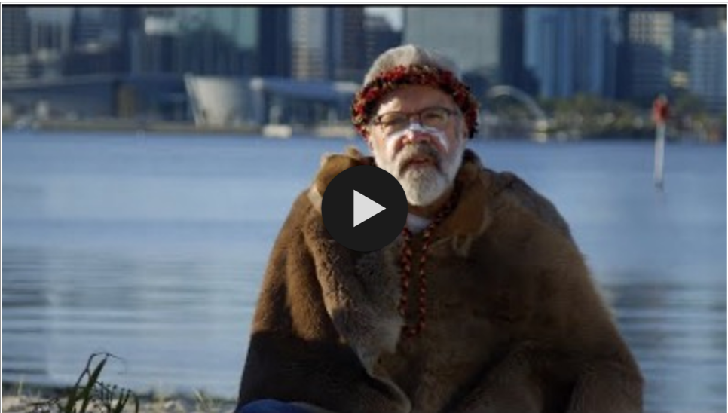

CAI3SP
WELCOME TO COUNTRY
Emeritus Professor Simon Forrest
PEOPLE
people-centred
PEDAGOGY
globally-placed
PRACTICE
paradigm-shifters
CRICOS Provider Code 00301J

Slide 3
The CURTIN ACADEMY
Showcase Proceedings
// Welcome of Guest
// Opening Address
// Welcome to Country
// Welcome Address by Deputy Vice Chancellor (Global)
// Learning Engagement Address by Deputy Vice Chancellor (Academic)
// Student Learning Presentation (NCP Miri & Singapore Experience)
// Student Pitches
// Acknowledgements by Curtin Academy Chair
// Closing of Event
// Networking & Drinks
PEOPLE
people-centred
PEDAGOGY
globally-placed
PRACTICE
paradigm-shifters
Curtin Academy Study Tour Showcase
Curtin Academy
Curtin University, AUSTRALIA
CRICOS Provider Code 00301J
March, 2023
Perth, WA
Notes:
Students are co-partnering in a consortium of educators and thought leaders from the Curtin Academy and industry experts.

Slide 4

CAI3SP
JOURNEY OF EMPOWERMENT
CHALLENGES &
OPPORTUNITIES
2020, 2021
2022, 2023
Deliverables VS Expectations
Delay due to Global Pandemic Crisis (COVID)
Bridging the gap between learning disciplines
240 Students
20 staff
On site challenges
PEOPLE
people-centred
PEDAGOGY
globally-placed
PRACTICE
paradigm-shifters
Largest Cohort mobilized by Curtin University
Destination,
Health & Safety,
Local Requirements
CRICOS Provider Code 00301J

Slide 5
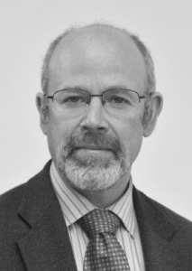
CAI3SP
WELCOME
ADDRESS
WELCOME ADDRESS
Professor Seth Kunin
Deputy Vice Chancellor - Global
Curtin University
PEOPLE
people-centred
PEDAGOGY
globally-placed
PRACTICE
paradigm-shifters
CRICOS Provider Code 00301J

Slide 6
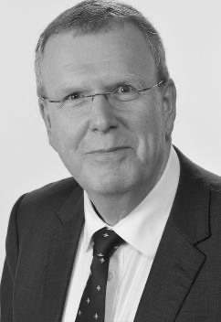
CAI3SP
LEARNING
ENGAGEMENT
ADDRESS
LEARNING ENGAGEMENT ADDRESS
Professor Paul Brunton
Deputy Vice Chancellor - Academic
Curtin University
PEOPLE
people-centred
PEDAGOGY
globally-placed
PRACTICE
paradigm-shifters
CRICOS Provider Code 00301J
Notes:
CA-I3SP has been the first Curtin mobility program to provide students with the important triple “I” experience of an international interdisciplinary industry-focused research study.

Slide 7
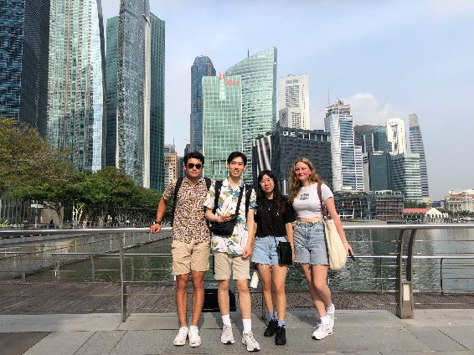
NCP Visit to Singapore
Thoughts from the DVCA
Professor Paul Brunton

Slide 8
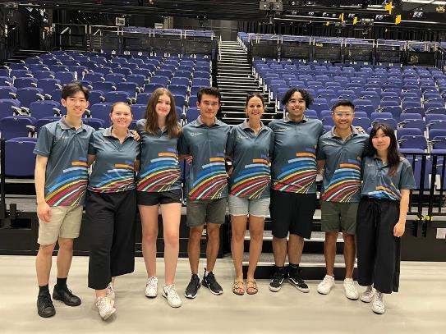
What a great opportunity…
Cultural immersion
Global perspective
Widening horizons
Interfaculty working and co-operation

Slide 9
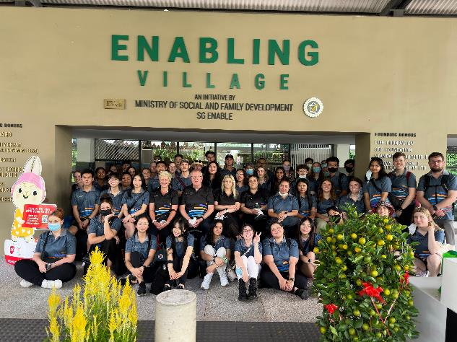
Doing things in a different way…

Slide 10
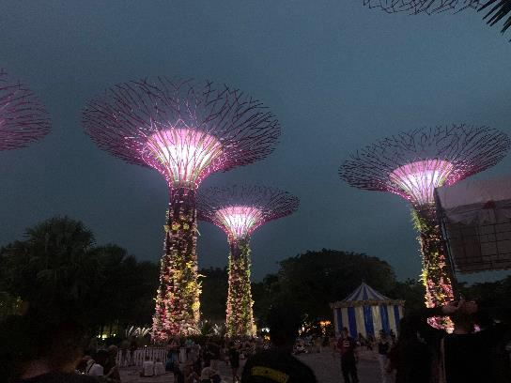
Personal Reflections….
Confronting
Demanding
Personally enjoyable
Clash of cultures

Slide 11
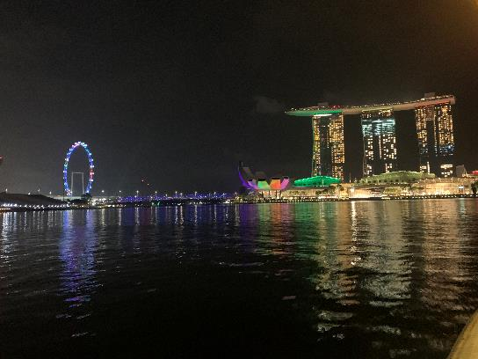
Thanks are due…
Thanks for the invitation
Organisers
Support
Students
What next?

Slide 12
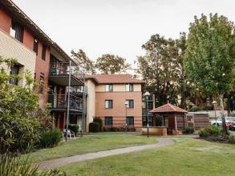
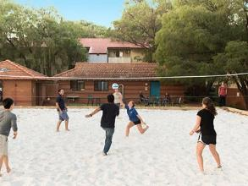
Thank You

